Slide 1
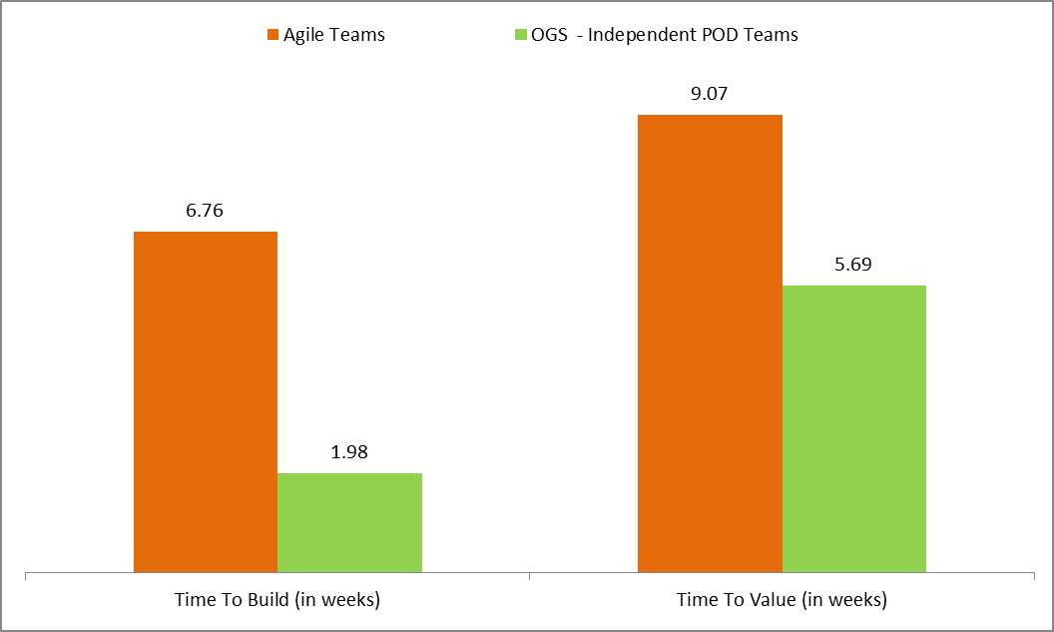
Agile Metric – Feature Cycle Time
Total of 14 scrum teams following agile across Rx
As part of Hybrid COE - 2 Independent scrum teams @ OGS (Mirai & ePA)
Total of 131 features built with 69 feature moved to production
OGS POD teams has built 17 features with 14 features moved to production

Slide 2
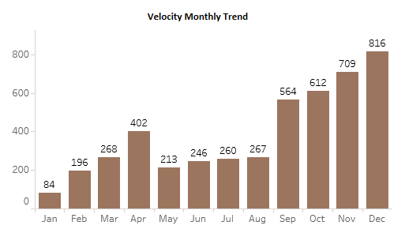
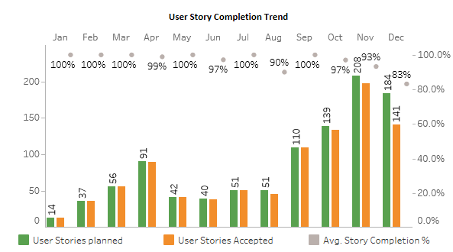
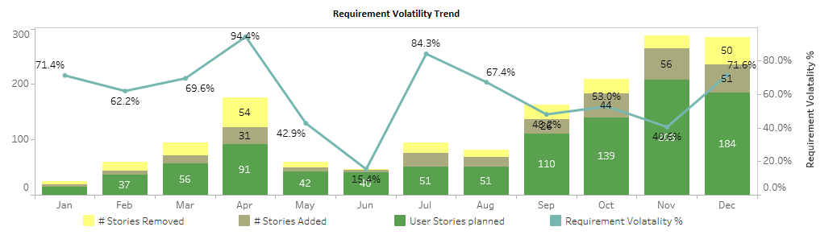
Agile Metrics

